Slide 1

Binary Classification with a Tabular Reservation Cancellation Dataset
Авторы:
Трифонов Степан
Кривенко Михаил

Slide 2
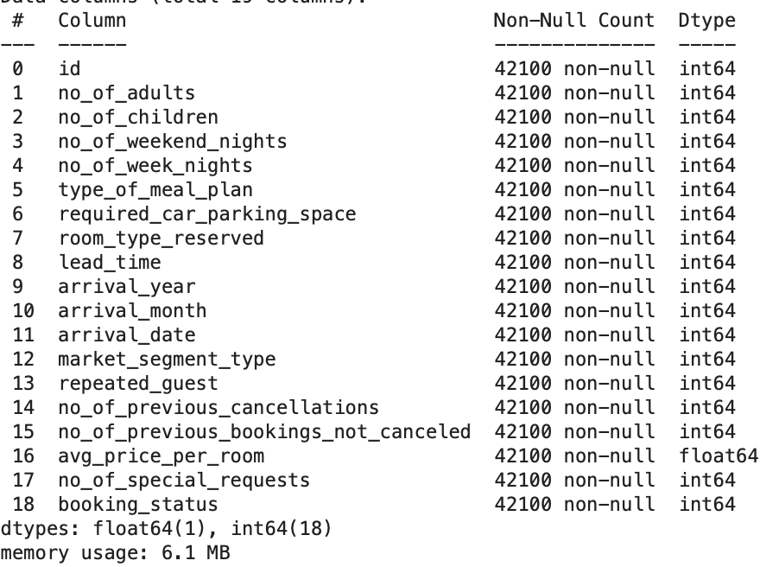
Description of the data and the task
The dataset for this competition (both train and test) was generated from a deep learning model trained on the Reservation Cancellation Dataset
It is necessary to predict the target variable - whether the reservation was canceled

Slide 3
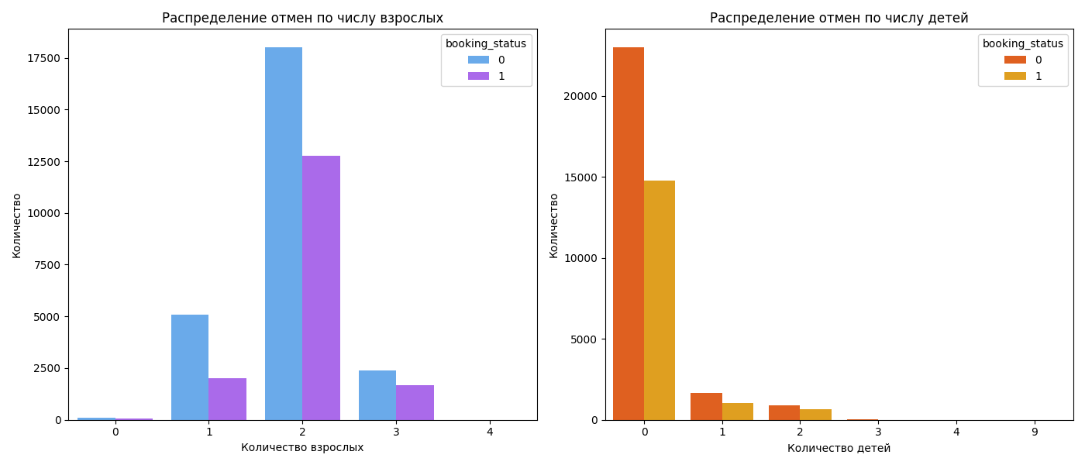
Data visualization

Slide 4
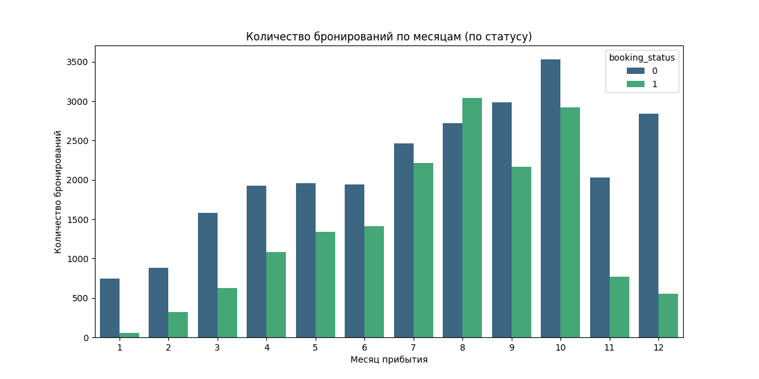
Data visualization

Slide 5
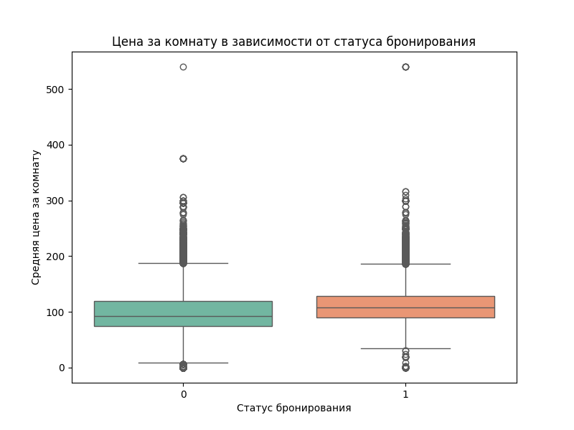
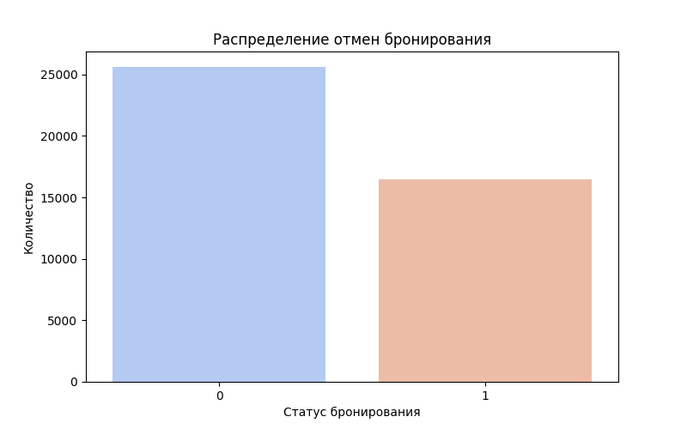
Data visualization

Slide 6
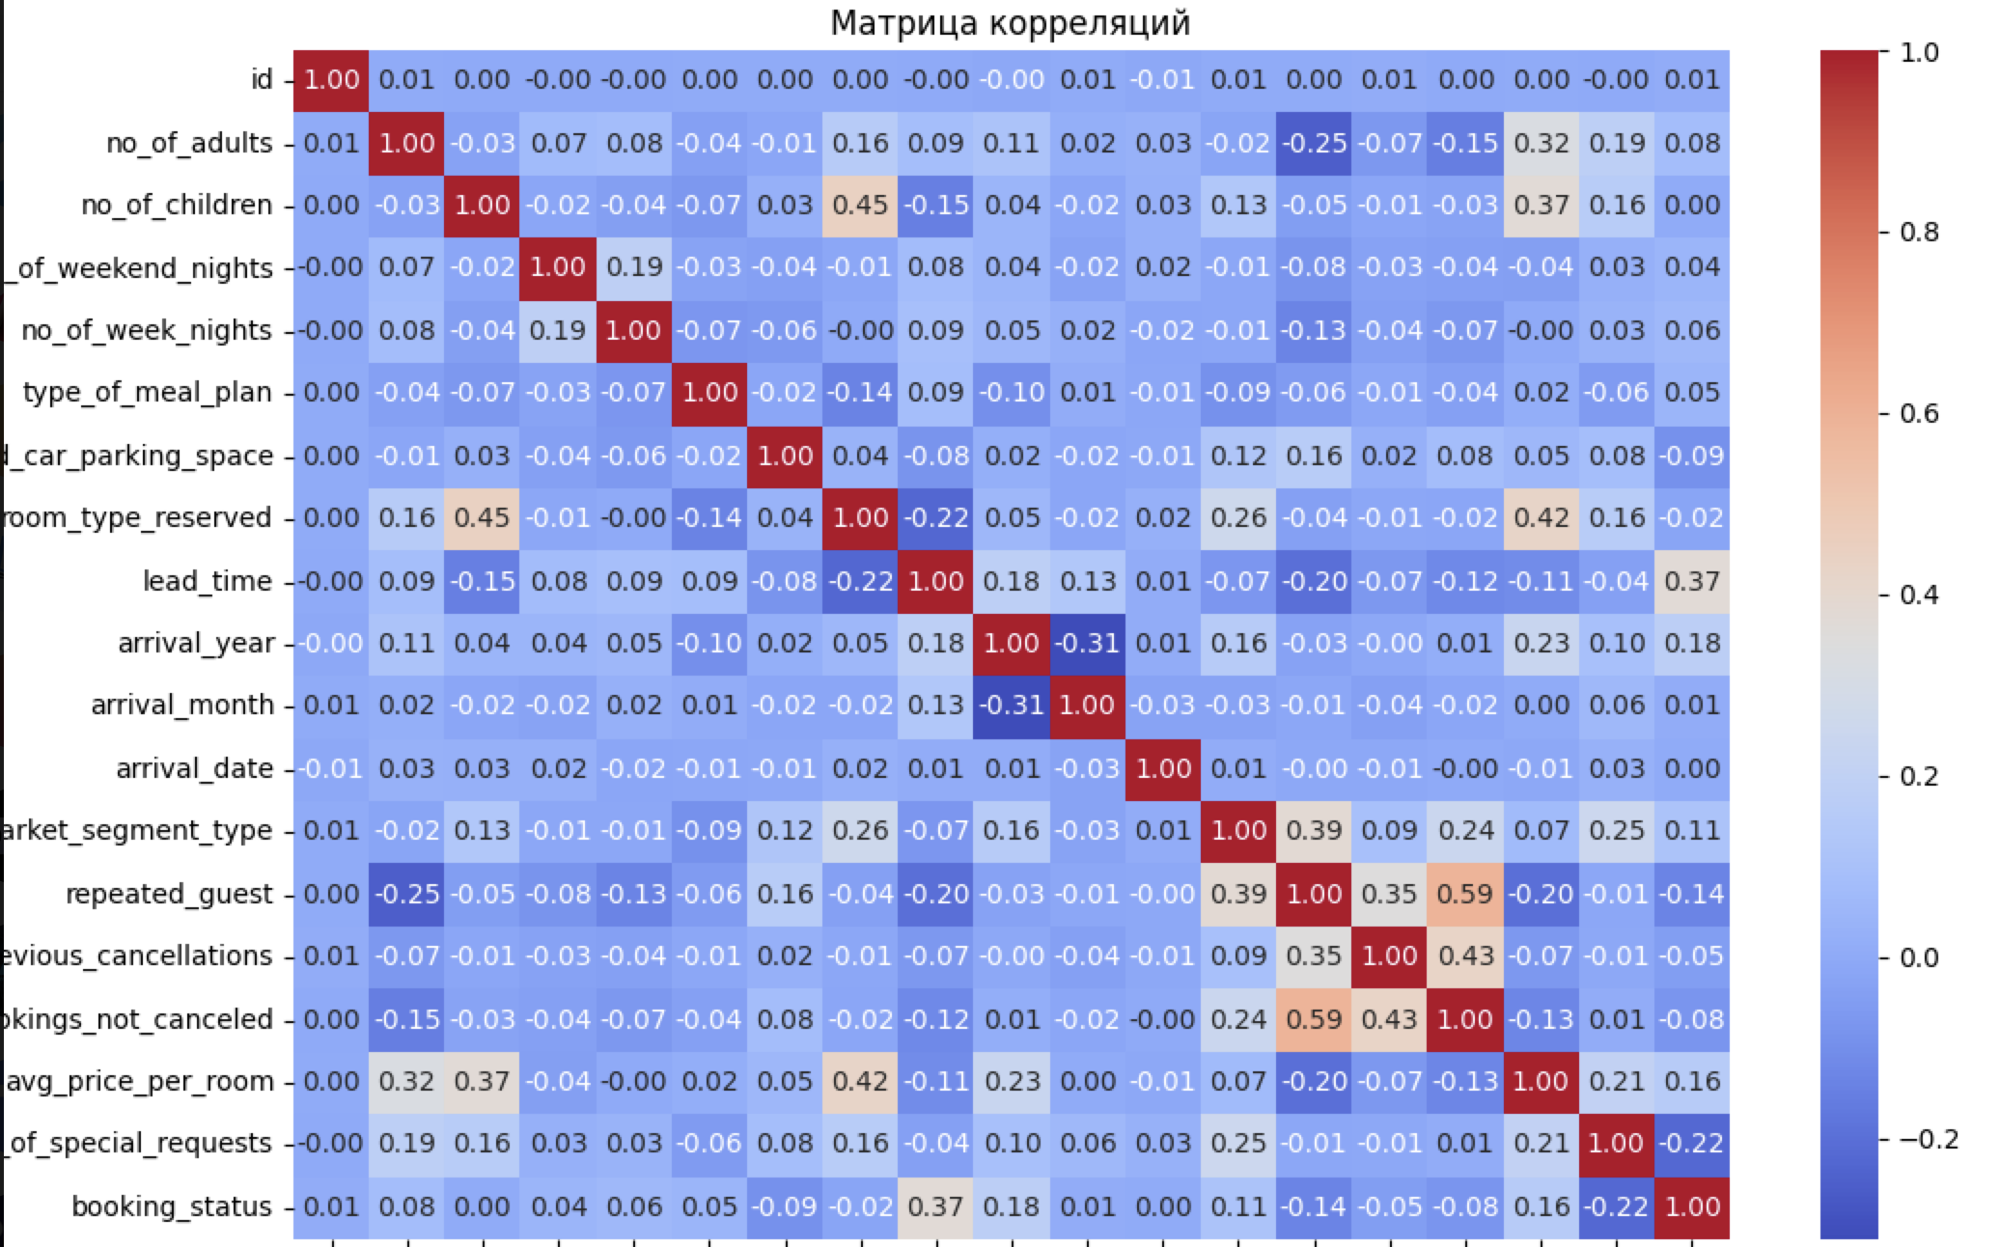
Data visualization

Slide 7
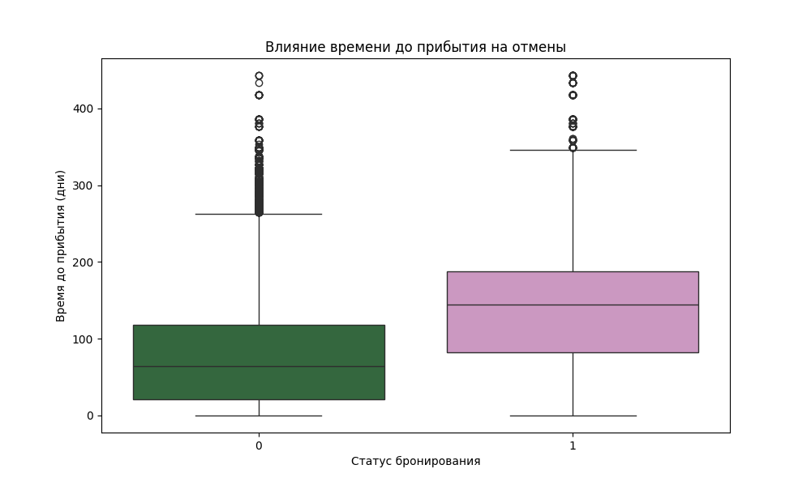
Data visualization

Slide 8
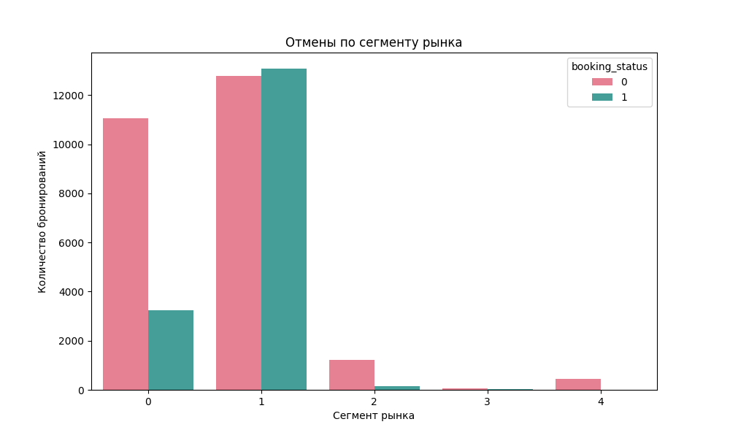
Data visualization

Slide 9
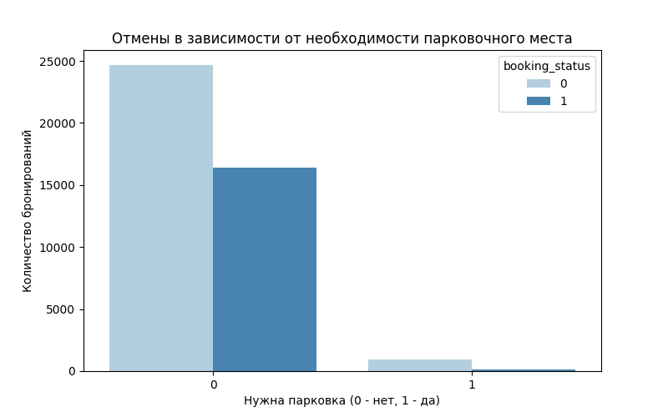
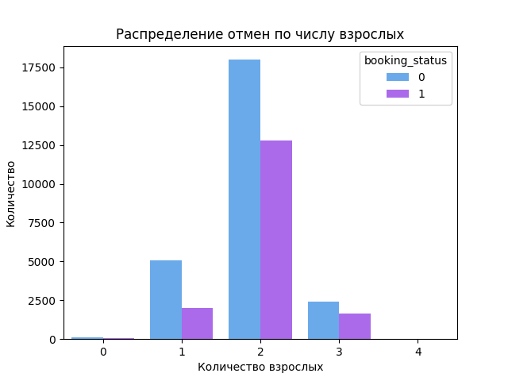
Data visualization

Slide 10
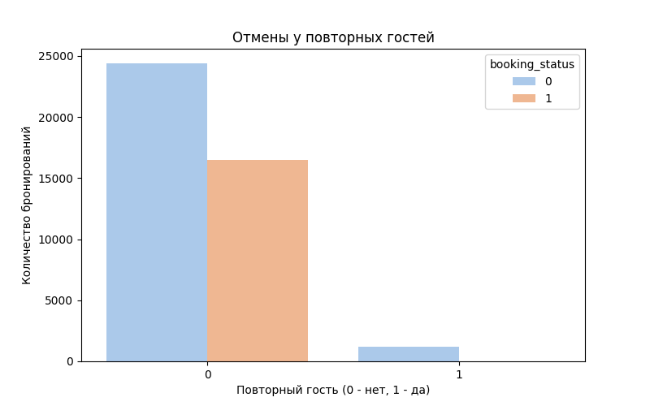
Data visualization

Slide 11
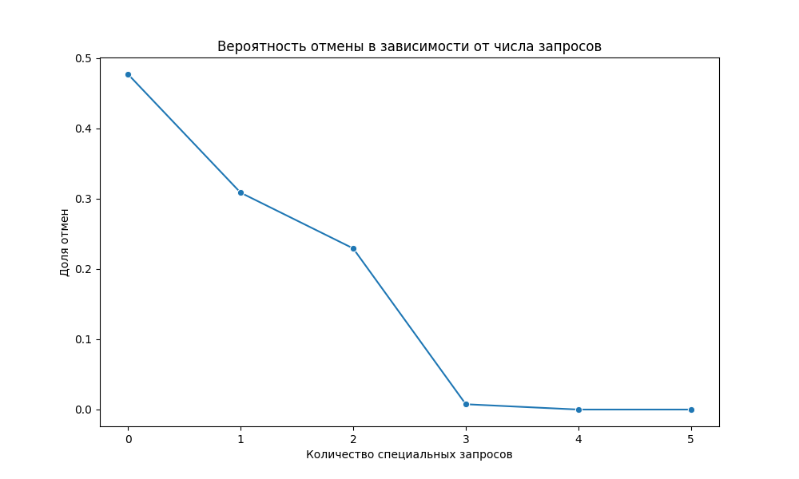
Data visualization

Slide 12
Data preparation and Train
1. LightGBM (LGBMClassifier): - Gradient boosting on root trees, optimized for speed and performance.
2. XGBoost (XGBClassifier): - Another popular implementation of gradient boosting, known for its efficiency and accuracy in classification and regression tasks.
3. CatBoost (CatBoostClassifier): - A specialized library for working with categorical invitations; gradient boosting is used.
Adding polynomial features
Detecting outliers
Detection of categorical features
Stacking/Blending. Meta-training that uses the results of the predictions of three models to improve the final predictive ability. This is achieved by optimizing the weights of the models using the Nelder-Mead method to maximize the ROC AUC estimate.
Use early_stopping_rounds

Slide 13
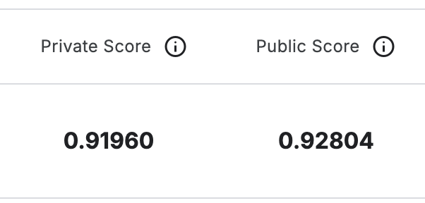
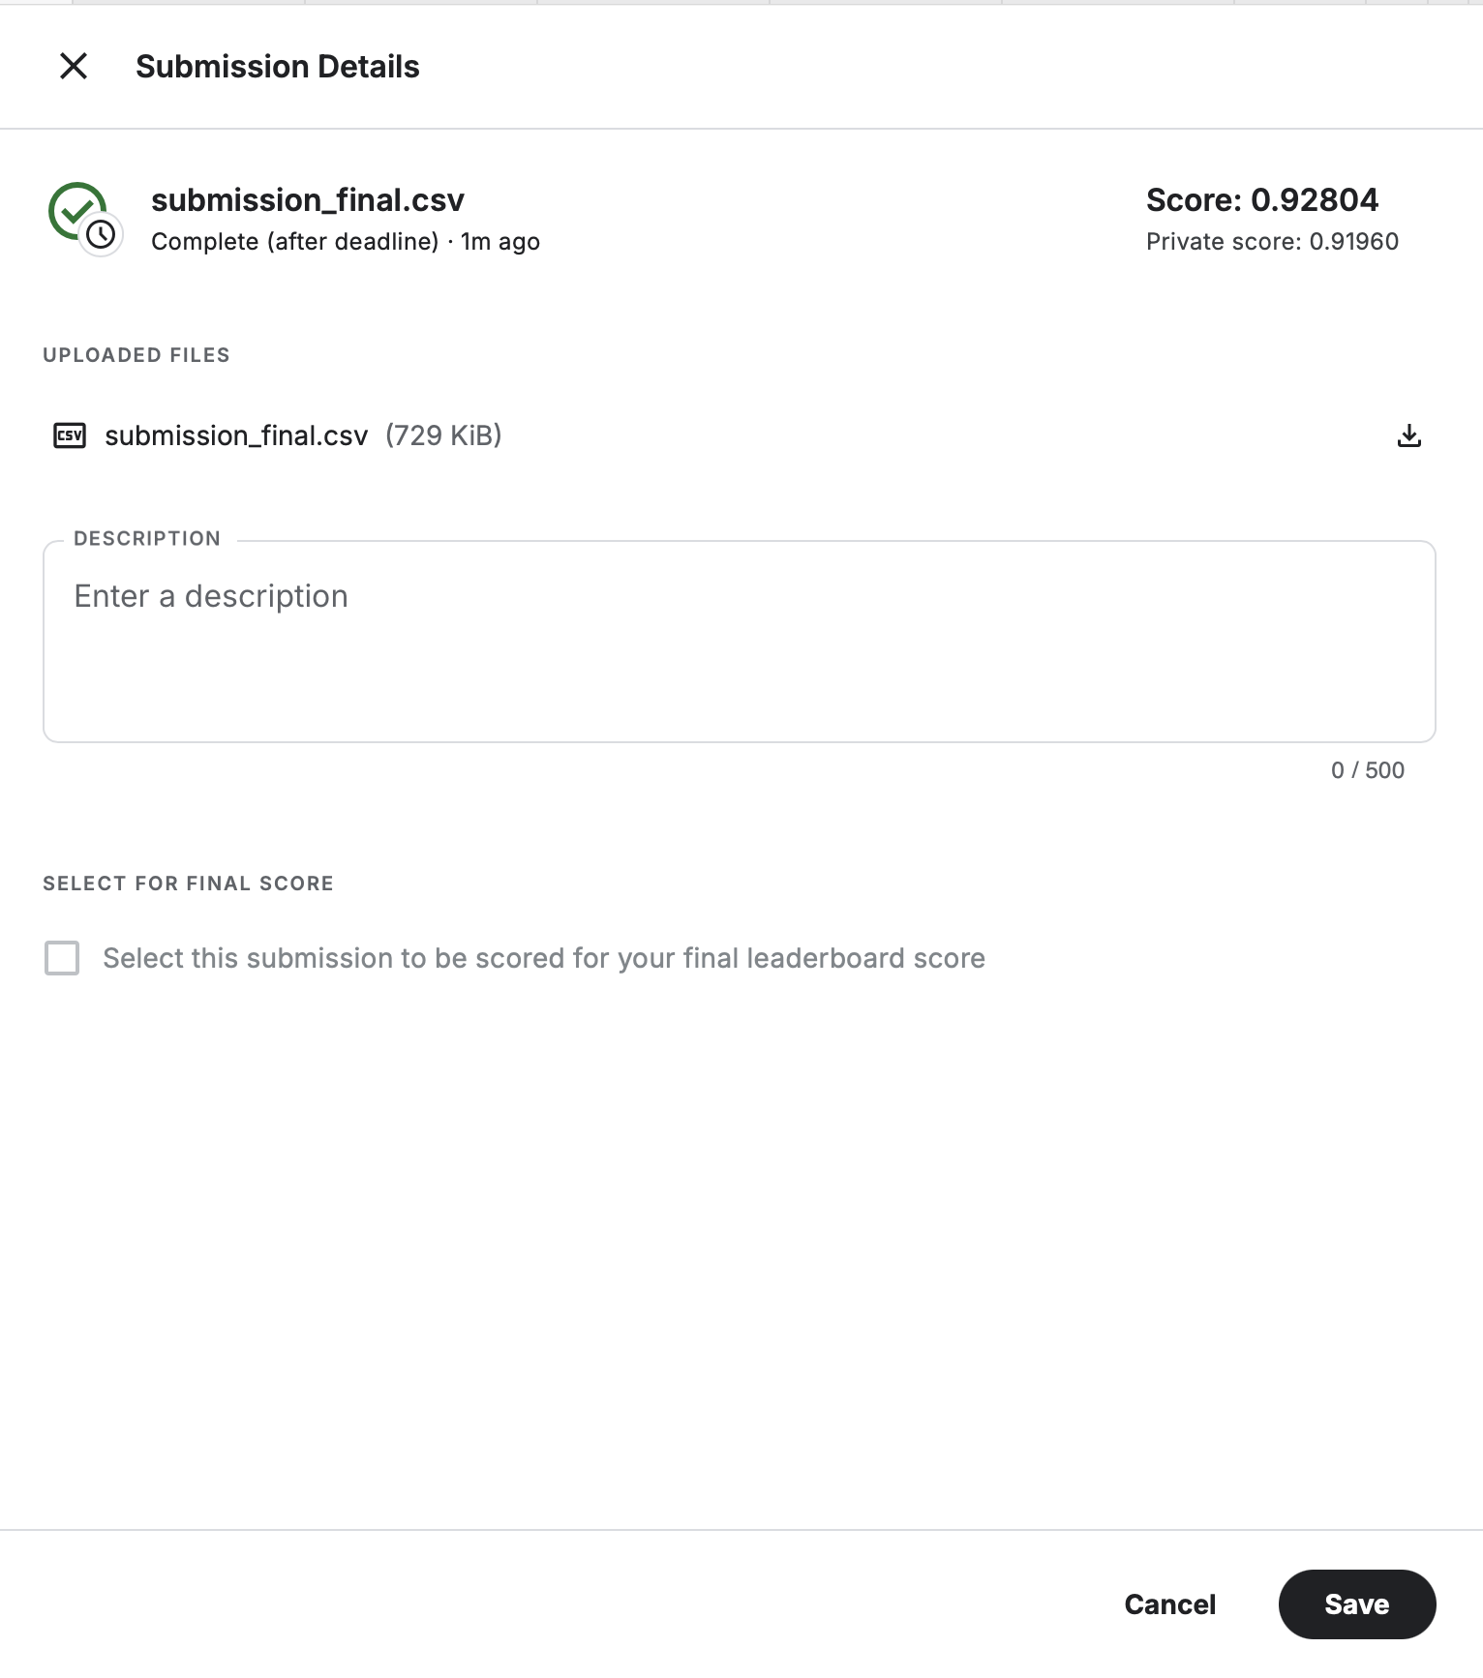
Result
75 private perc 85 private perc 95 private perc
0,9036
0,91136
0,91795

